Slide 1
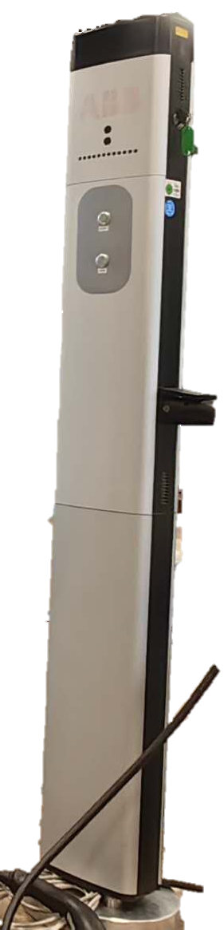
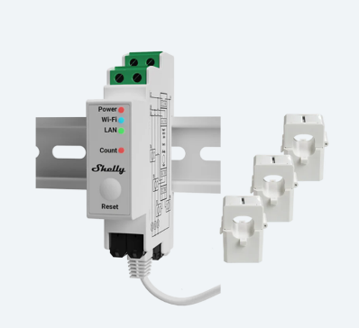
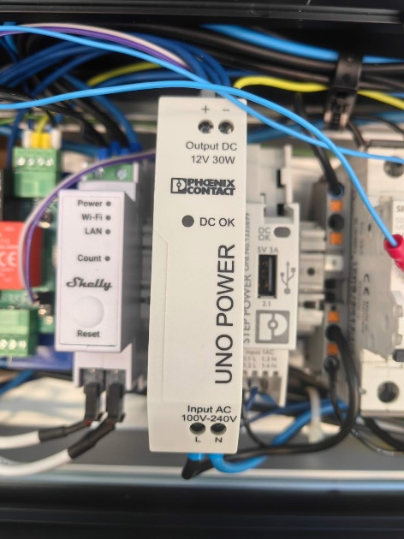
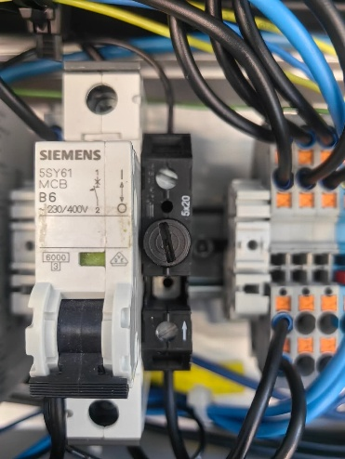
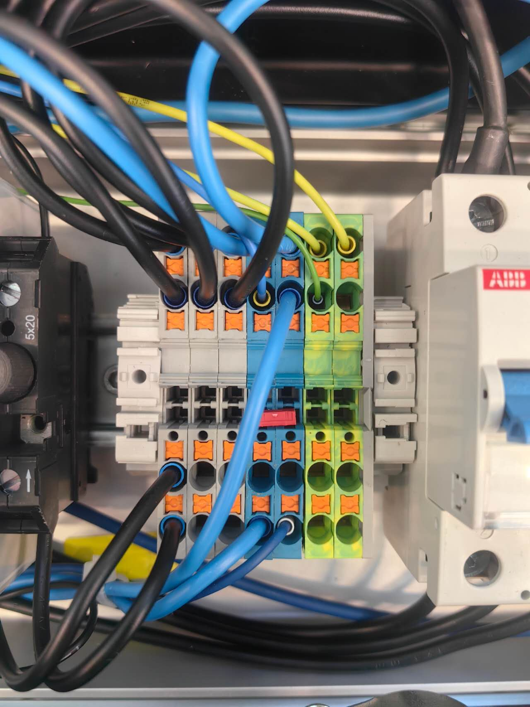
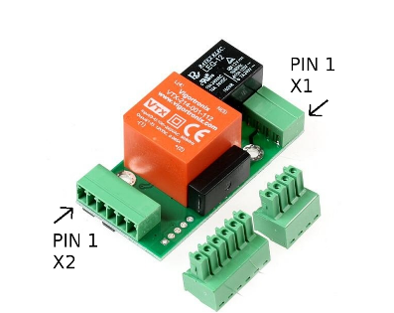
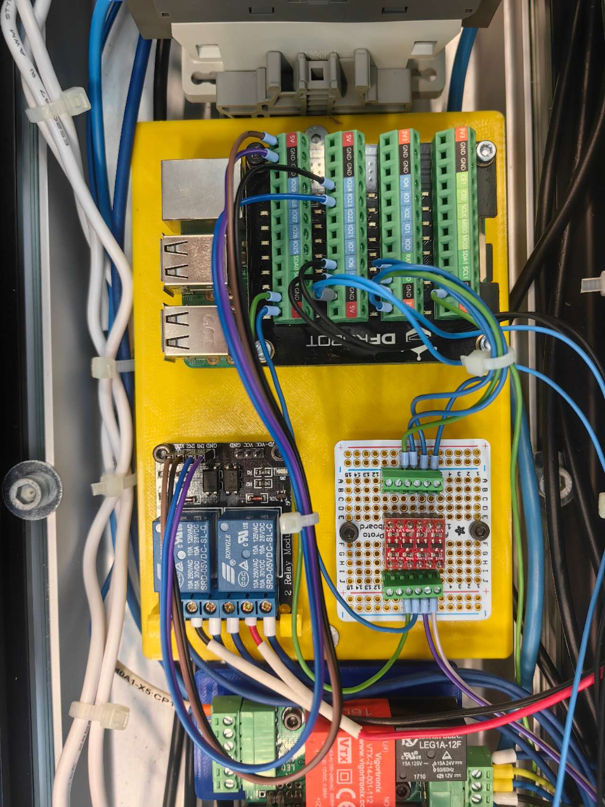
Hardware
Shelly sensor
Power supply, Circuit breaker, Fuse, Wire connector, etc.
EVSE
SmartCharge Board
Auxiliaries
Original charge station
Main functional components
Notes:
Our charging station is mainly composed of these parts

Slide 2
Main functional components
Shelly sensor
Shelly Pro 3EM
3 current clamps measure the 3-phase current: used for Data Visualization.
Record total charged energy: used for the Calibration of the charge plan.
EVSE
Electric Vehicle Supply Equipment
Communicate with EV in the form of PWM signal and voltage level, indicating the maximal allowed current and vehicle state.
Controlled by reading/writing the corresponding registers via Modbus communication
Notes:
The main functional components include a shelly sensor. This sensor can measure the current of the 3-phase power with its clamps and record total charged energy.
EVSE stands for Electric Vehicle Supply Equipment. It is mainly used to set the max current and get the vehicle state.

Slide 3

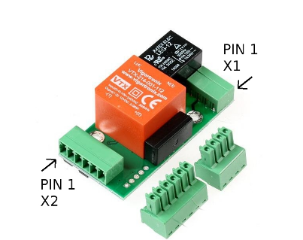
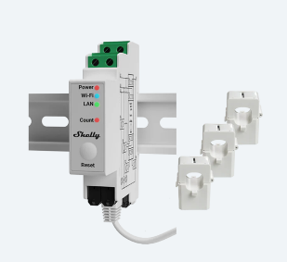
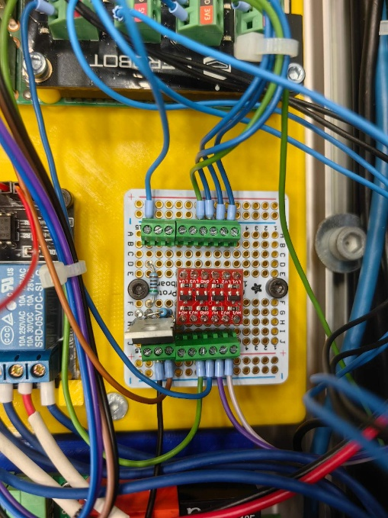
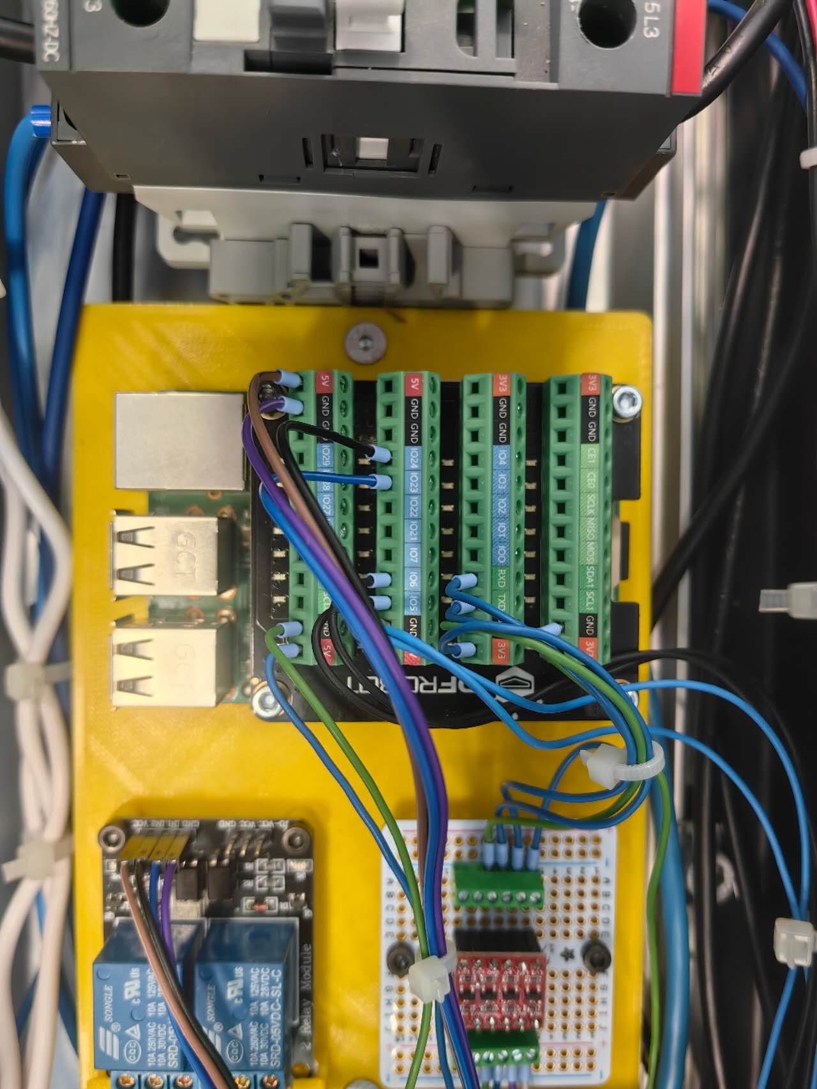

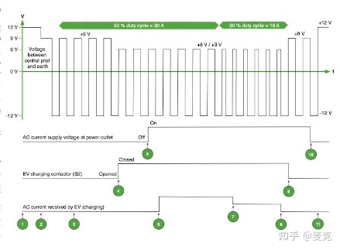

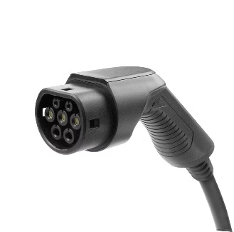
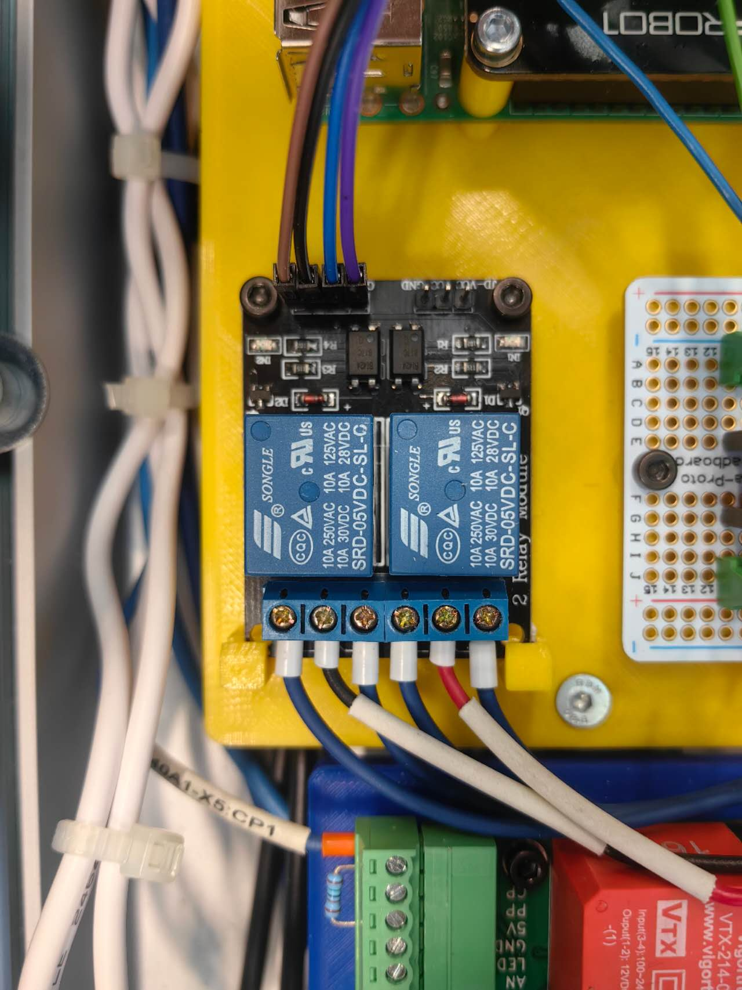
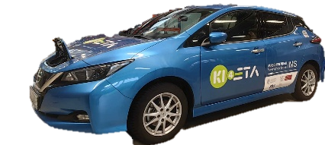
Main functional components
Web port
3.5V
Level shifter
5V
EVSE
GPIO
HTTP request
Modbus
Shelly
Raspberry Pi
GPIO
LED
PWM signal
Latch motor
Relay
Notes:
The smart charge board is the most important part. It is a 3D-printed board to mount the components on the charging station.
Raspberry Pi is the carrier of the program. It communicates with different components in various ways.
Shelly， the web port, and Raspberry Pi are connected to the same Wifi and transmit information via HTTP request.
The Raspberry Pi communicates with EVSE via Modbus communication. But the working voltage of these two parts is different. So we add a level-shifter in between to convert the voltage. Otherwise the GPIO pins will be damaged.
The EVSE communicates with the EV using PWM signal. The duty cycle represents the allowed current, and the voltage level represents the vehicle states.
We also utilized the GPIO pins of Raspberry Pi for other purposes like latching the charge plug with motor and relay, controlling the blinking of LED.

Slide 4



Charge modes
Direct charging
Manual schedule
Dynamic adjustment
Start
Stop
Buttons on the charge pile or website
Charge according to the uploaded schedule
Start time, power of each section
The schedule is generated by the optimizer according to the user’s needs.
Calibration of the charging plan periodically
Notes:
We have designed 3 charge modes.
Direct charging can literally only control the start and stop of charging, by pressing the buttons on the charge pile or via the website. Then the charge station will charge at the maximum allowed current.
The Manual schedule mode is mainly used for debugging. The charging station will charge according to an uploaded schedule. The charge time point and charge power are defined in this schedule.
The dynamic adjustment mode is the main target of our project. It realizes the smart charging. The schedule is generated by the optimizer according to the user’s needs such as “lowest electric price” or “balanced price and speed”. The charging plan will be calibrated periodically to compensate for the deviation in the charging process, based on the data collected from the shelly sensor.

Slide 5
Detailed charging steps
Plug in the charge plug
Select the charge mode and start
Before charging
In charging
Charging ends
EVSE:
EV is present
Check:
Vehicle,
EVSE,
Shelly, applicable plan
Latch plug
The optimizer generates the charge schedule
Max. current to EVSE
Calibration
Polling-EVSE, Shelly
Unlatch
Clear data
If not
ERROR
Hardware failure
Notes:
The charging stations will perform different actions at different stages of charging.
When the user inserts the charge plug selects the charge mode and presses the start button. The system will check if all the components are working properly, and also check if the plan is applicable, for example, the user wants to fully charge the car in 5 minutes. It will be rejected because the required power is clearly much higher than the power limit.
Anything that shows abnormality in this process will lead to an error, the charging will not start.
If everything is OK, the station will latch the plug, the optimizer will generate the charge schedule.
In the charging process, the output power is controlled by changing the maximum current value in the EVSE register.
The system will periodically calibrate the plan, and get data from the EVSE and the Shelly sensor via polling. If any hardware failure occurs in this process, it will also raise an error and immediately terminate the charging.
After the charging is finished, the charge station will unlatch the charge plug and clear the data stored in Shelly.

Slide 6
Trim of plan – Influence of delay
System response delay
Network delay
Charge
unit 1
1kW
2kW
1kW
2kW
Charge
unit 2
4kW
2kW
delay
4kW
2kW
Charge
unit 3
1kW
2kW
1kW
2kW
8kW
Limit
(6kW for example)
6kW
6kW
6kW
6kW
2kW
1st hour
2nd hour
1st hour
2nd hour
Notes:
In our project, we have considered a lot about the influence of delays.
For example, according to the plan the 3 charge units should charge without violating the limit. However, due to the System response delay and Network delay, the charge schedule of unit 2 arrived later.
Consequently, the total power exceeds the limit for a certain duration. This may cause equipment overload.

Slide 7

Trim of plan
Arrive of New schedule/
Schedule update
Now
New schedule start time is in future
Old schedule
New schedule
Time
Arrive of New schedule/
Schedule update
Now
Old schedule
New schedule after truncation
New schedule
Time
Cut off
New schedule start time already passed
Notes:
To solve this, the system will not directly execute the new schedule.
If the new schedule starts in the future, the system will wait or continue with the old schedule.
If the new schedule start time point is already passed, the system will cut off the expired parts of the schedule, and continue with the rest.

Slide 8
Trim of plan
Before truncation
After truncation
Charge
unit 1
2kW
2kW
1kW
1kW
Charge
unit 2
delay
4kW
2kW
4kW
2kW
Charge
unit 3
1kW
2kW
1kW
2kW
8kW
Limit
(6kW for example)
6kW
6kW
6kW
6kW
2kW
2kW
1st hour
2nd hour
1st hour
2nd hour
Notes:
In this way, this risk is avoided and the deviation will be compensated by the following calibrated schedule.

Slide 9
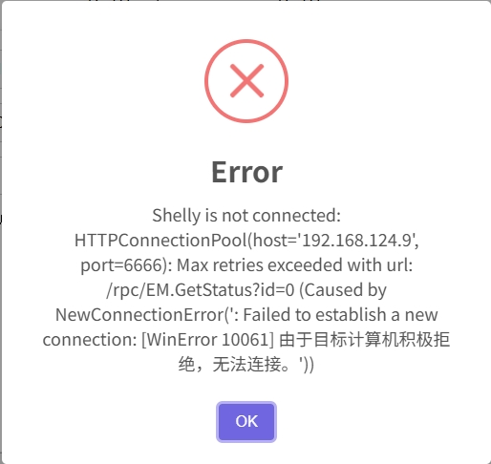
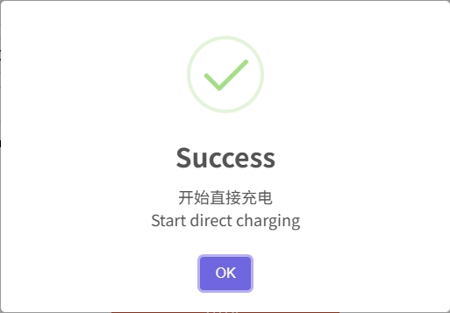
Observe the charging state
按钮图
LED light on the button
pop-up window
Notes:
In our testing stage, we found it very useful to let the charge station have a response to our command, therefore, apart from the pop-up window on the website, we also utilized the LED light embedded in the button. We let the LED blink at different frequencies to indicate the current charging steps.

